Slide 1
Shop App
By Anusha Mandepudi Arun Chary Gattoji
Bhuvaneswar Reddy Kunduru
Suprith Son Dubba

Slide 2
INTRODUCTION
Our project involves building a user-friendly e-commerce website, designed to provide an enjoyable shopping experience. It includes features like easy product browsing, a functional shopping cart, user accounts for personalized shopping, and an admin panel for efficient product and order management.
Technology Stack
Using React JS for front-end development and Firebase for Authentication and Database management .

Slide 3
Key Objectives
Core Features
User Accounts
Easy registration and profile management.
Product Browsing
Categorized and searchable products.
Shopping Cart
Easy item management and dynamic pricing.
Admin Panel
Product and order management.
User-Friendly Interface
Intuitive browsing and quick access to products.
Efficient Shopping Process
Functional shopping cart and streamlined checkout.
Personalization through User Accounts
Tailored shopping experience based on user preferences.
Empowerment with Admin Panel
Efficient product and order management

Slide 4
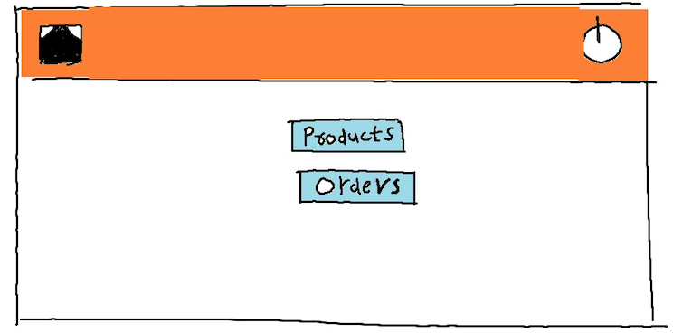
ADMIN

Slide 5
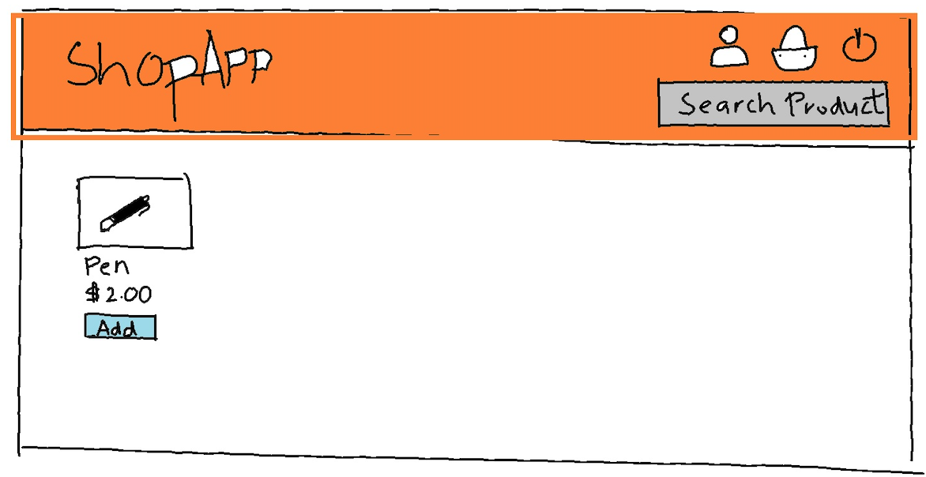
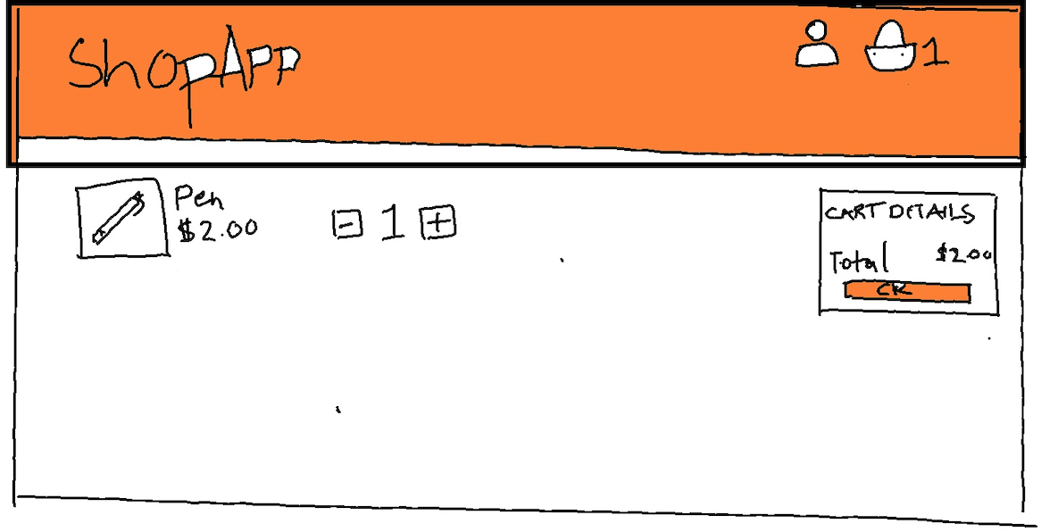
USER

Slide 6
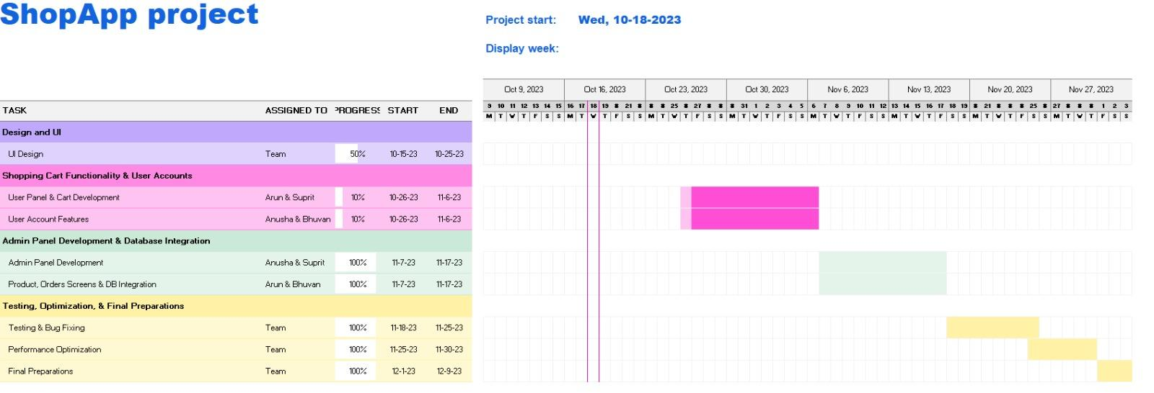
GANTT CHART

Slide 7
THANK YOU

